Slide 1
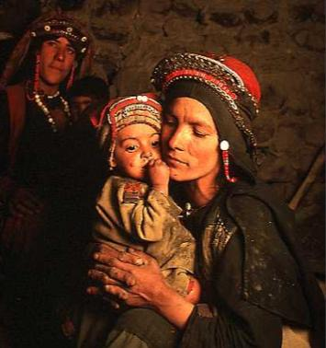
My Family

Slide 2
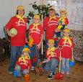










M O T H E R
B A B Y
G R A N D F A T H E R
F A T H E R
A U N T
U N C L E
B R O T H E R
S I S T E R
G R A N D M O T H E R

Slide 3
Знайди всі заховані слова
Mother jokplmotherk
Father hgrfatherokui
Son jthfsvjosouj
Daughter ksrdaughteryj
Brother tbrotherufhhbp
Sister yjgsistervbh
Aunt mnoutauntll
Uncle nniunkleser
Cousin cousinftkhed
Grandmother cdrgrandmothersde
Grandfather vhggrandfatherser
Notes:
Siste

Slide 4
Допиши слова
Тітка | A u - -
Сестра | S – s t - -
Мама | M - t - e -
Тато | F a - - e -
Брат | - r o - h e -
Бабуся | G-an-m-th--
Дядько | U - c - e
Син | - - n

Slide 5
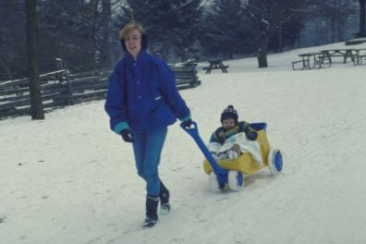
Guess the riddles:
It is your parents’ child. It is neither your brother nor your sister. Who is it?
Two people are walking along the street. One says, “This is my father’s house. But I am not his son. Who speaks?

Slide 6
Здогадайся які слова задумані у кросворді
 |  |  |  |  |  |  |  |  | E | R
 |  |  |  |  |  |  |  |  | E | R
 |  |  |  |  |  |  |  |  | E | R
 |  |  |  |  |  |  |  |  | E | R
 |  |  |  |  |  |  |  |  | E | R
 |  |  |  |  |  |  |  |  | E | R
 |  |  |  |  |  |  |  |  | E | R

Slide 7
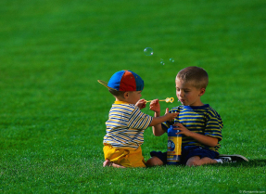
Have you got a brother?
Brothers/sisters
Play with each other
(don’t ) get on well
Argue with each other
Have arguments and fights
Only alone
Have my own room
Always alone
Do everything myself
Can’t talk to anybody
when I have got problems

Slide 8
Who are they?
A son of one’s brother or sister
A daughter of one’s brother or sister
Children born at the same time by the same mother
A son’s wife
A daughter’s husband
Parents of one’s mother
(grandparents, twins, sister-in-law, nephew niece, brother-in-law)

Slide 9


Slide 10
Look at the words. Note those of them which have pairs.
aunt boy daughter father
child cousin girlfriend grandfather
friend girl husband man
niece parent grandmother nephew
mother son wife woman
sister uncle boyfriend brother

Slide 11
M y s t o r y
My name is Natasha.
I am 9.
I have got a father, a mother and a sister.
My father is Misha.
He is 34.
He is a doctor.
He likes reading books.
My name is………….
I am …………..
I have got ………
My mother is…………
She is ………
She is………..
She likes ………….

Slide 12
Listen to children’s opinion about their parents’ responsibilities:
Parents must give their children more love.
Parents must talk to their children more often.
Parents must try to understand their children.
Parents must give their children more freedom.
Parents must help their children with problems they have at school.

Slide 13
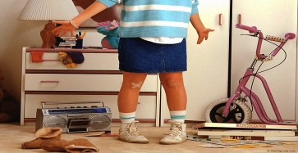
Do you help your mother?
To wash dishes, to cook
To do the ironing to tidy up the room
To clean the house to sweep the floor
To do the washing to go shopping

Slide 14
Family rules
We should help each other;
We should support each other;
We shouldn’t quarrel;
We should help our mother about the house;
We should be polite;
We should do any work thoroughly ( home task, work about the house, etc.).

Slide 15
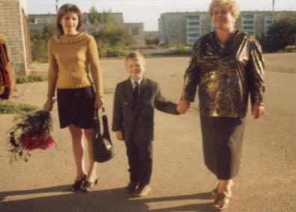
Finish the sentence:
In a friendly family members
In a hospitable family members
In an ideal family members
In a conservative family members

Slide 16


Thank you for your work!

Slide 17
Список використаної літератури
1.Англійська мова і література 4 клас./О.Д.Карп`юк. Київ “Перун” 2004
2.Young Chiildren`s Picture Dictionary. PEARSON Longman 2007.
3.www.bbcworldservice.com/learningenglish
4. www.teachingenglish.org.uk
5. www.teachingenglish.org.uk
6.www.supersimplesong.com

