Slide 1
Презентація теми «Мас медіа» англійська мова 8 клас
Марусич Жанна Володимирівна
учитель англійської мови
Буцька загальноосвітня школа
І-ІІІ ступенів

Slide 2
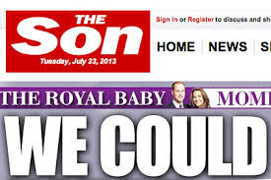
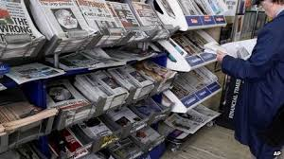
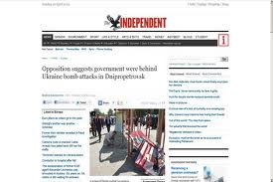
British press

Slide 3
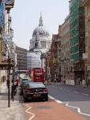
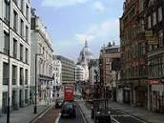
The symbol of British Press Fleet Street

Slide 4
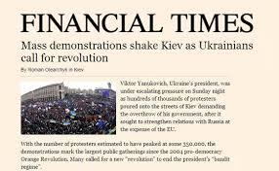
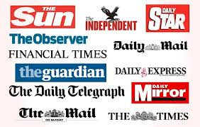
Questionary for the interview What kinds of Mass Media do you know?
Which is the most popular of them? Why?
What British newspapers and magazines do you know?
How often do you read newspapers or magazines?
What types of articles do you prefer?
What do you usually watch on TV?
Do you often listen to the radio? Where do you usually do it?
Do you look at news sites on the Internet?
What do you often look for in the Internet?
Do you prefer them to traditional newspapers?

Slide 5
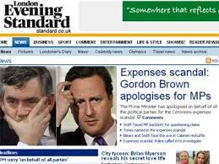
Problem Vocabulary:
circulation – тираж
distribution – розповсюдження
finance -- фінанси censorship – цензура
to cater – постачати
complaints – скарги
prevention - запобігання
intrusion – втручання
A heading- заголовок,рубрика
A headline - заголовок газети
Quality- якість
To cover- покривати
To catch the eye- приваблювати погляди
To provide the material about- надавати матеріал про
To succeed in doing something- досягати мети у чомусь

Slide 6
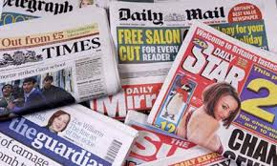
What do you know about the press in Great Britain?
Is Great Britain really a newspaper reading nation?
Do the British national newspapers use computer technologies?
What do you want to know about the Press and Broadcasting in Great Britain?

Slide 7
COMPLETE THE SENTENCES
1.Papers in Britain are divided into…
2. The quality papers are…
3. The tabloids are…
4. Sunday papers are…
5. A number of papers produce colour magazines are…
6. British press provides reading material about…
7. The bright covers of magazines for women are…
8. There are magazines for…

Slide 8
Answer the questions
What else do newspapers, do besides reporting the news and interpreting it?
What kind of information can one find in a pa­per?
In what two different ways do papers treat infor­mation?
How can you tell a popular paper from a serious one by looking at it?
What categories of newspapers can you name? How do you categorize them?
What's the symbol of the British Press and why?
Can you remember the names of the British quality papers and tabloids?
What are Sunday papers?

Slide 9
Types of newspapers
Quality papers
Tabloids
Sunday papers
“The Times”
“The Gardian”“The Financial Time”
“The Independent” “The Daily Telegraph”
“The Daily Mail”
“The Sun”
“The Daily Express”
“The Sunday Sun”

Slide 10
British Newspapers
DAILY
WEEKLY
MORNING
EVENING
LOCAL
NATIONAL
INTERNATIONAL

Slide 11
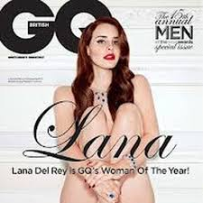
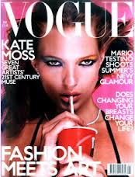
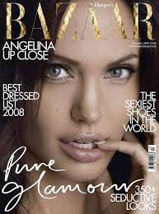
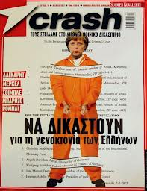
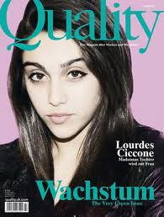
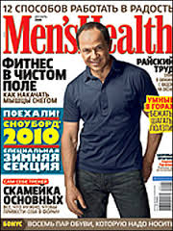
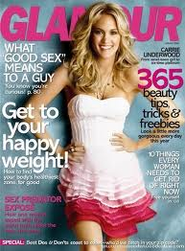
British magazines

Slide 12
Enjoy your reading!

Slide 13
Список використаних джерел
Література:
О. Карпюк «Англійська мова» 8 клас,вид. «Астон», Тернопіль
Інтернет-ресурси:
www.ksenstar.com.ua/
www.britishcouncil.org.ua
www.yrok.net.ua

