Slide 1
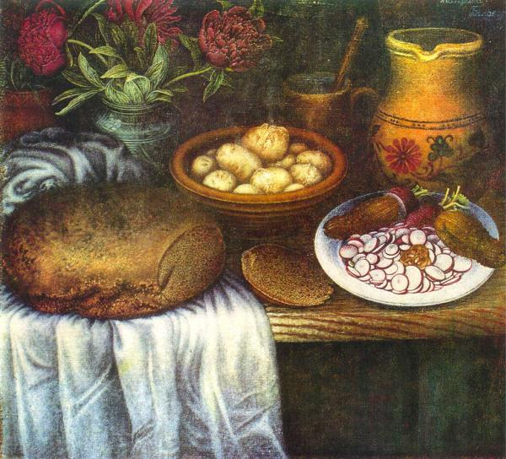
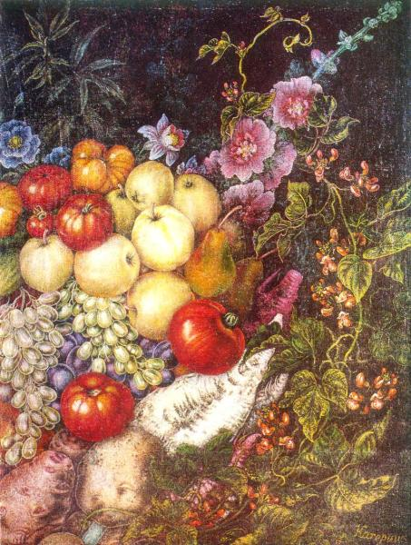
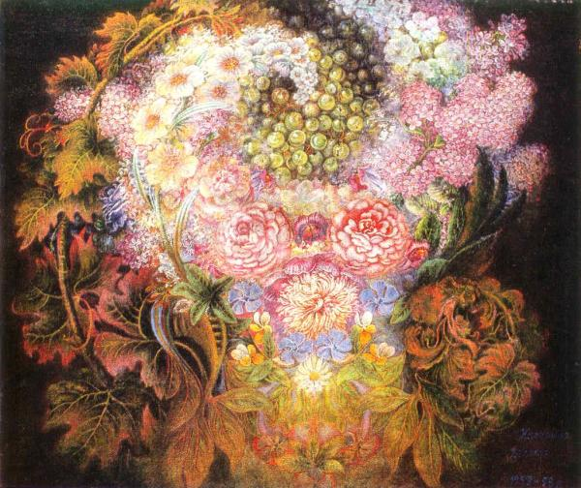
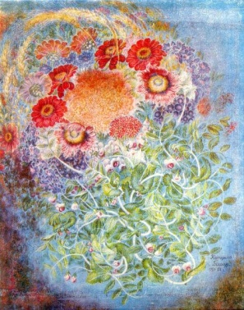
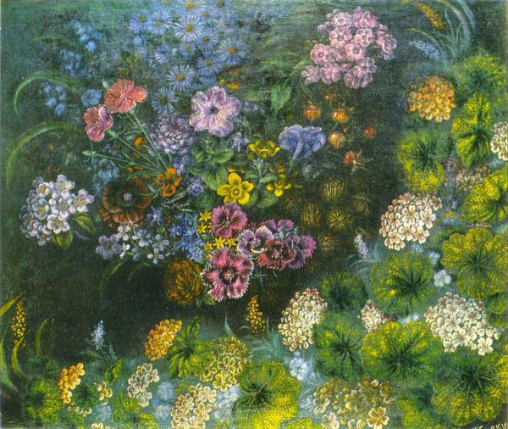
Cateryna Bilokur

Slide 2
A century have passed since the birth of a great Ukrainian artist-Kateryna Bilokur.

Slide 3
Kateryna Bilokur was born in a peasant family in 1900 in the village of Bohdanivka near Yahotyn. She did not have any education and had to study by herself.

Slide 4
She mastered literacy, read a lot and her soul craved for something unattainable

Slide 5
She said to herself that sooner or later she would become an artist. She kept repeating that life without art wasn’t possible for her

Slide 6
She had been very gifted in painting sicnce her early childhood. At first she began painting portraits of her relatives and villagers. In her later works Kateryna would extol a flower- the beauty of the land

Slide 7
Her tender poetic soul was mostly charmed by flowers that blossomed around her house, in the gardens, meadows and fields. She called them “my children”. She also called the flowers “the eyes of the earth” and “the soul of the earth”

Slide 8
Some pictures have her own captions “made by K. Bilokur”

Slide 9
Kateryna Bilokur said “I’ll paint and paint flowers because I like to work on them so that I can’t find words to express my feelings to them , my great love for them”

Slide 10
Kateryna Bilokur first exhibited her paintings in Kyiv and Poltava in 1940-41, and her canvases were met with a great exciting

Slide 11
She died in 1961 of June in her native village Bohdanivka.
Katheryna Bilokur was one of the most gifted persons in our country.

